Slide 1
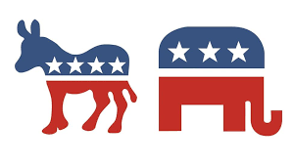
U.S.A ELECTION
Submitted by: mofazzal Hussain
Id:213100001

Slide 2
U.S.A Presidential Election History Overview
U.S.A Presidential Election History Overview Foundation of U.S.A Elections:
The U.S.A president is elected every four years, with elections held on the first Tuesday after the first Monday in November.
The U.S.A uses the Electoral College system, where each state is assigned electors based on its population.
The winner-takes-all system applies in most states (except Maine and Nebraska), where the candidate with the most votes wins all of that state’s electoral votes..

Slide 3
Key Historical Elections:
1800: First peaceful transfer of power between political parties (Jefferson vs. Adams).
1860: Abraham Lincoln’s election led to the Civil War and the abolition of slavery.
1932: Franklin D. Roosevelt's New Deal during the Great Depression.
1960: John F. Kennedy's election marked the era of television influence in campaigns.
2008: Barack Obama’s election as the first African American president.

Slide 4
How the U.S.A President is Elected
Step 1: Primary Elections and Caucuses : Held in each state, usually between January and June of the election year . Voters select delegates who pledge to vote for a particular candidate at the national party conventions . Both major parties, Democrats and Republicans, hold these primaries and caucuses to choose their presidential nominees.
Step2: National Conventions : After the primaries, each party holds a national convention (in summer of election year).Delegates officially nominate the party’s candidate for president and vice president.
Step 3: General Election Campaign : The presidential candidates from the Democratic and Republican parties (and potentially third-party candidates) campaign across the country . Voter turnout plays a critical role in this stage

Slide 5
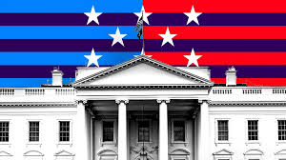
Step 4: Electoral College : On Election Day, citizens vote for electors in their state, who in turn vote for the president and vice president . Electoral votes are awarded to states based on population (total of 538 electoral votes).A majority of 270 votes is needed to win the presidency.
Step 5: Inauguration : The winner is inaugurated on January 20 of the following year.

Slide 6
U.S. Presidential Elections in the Last 10 Years (2014-2024)
2016 Presidential Election
Donald Trump (Republican) defeated Hillary Clinton (Democrat), despite Clinton winning the popular vote.
Electoral Vote: Trump secured 304 electoral votes, Clinton had 227.
Key swing states: Pennsylvania, Wisconsin, Michigan, Florida.

Slide 7
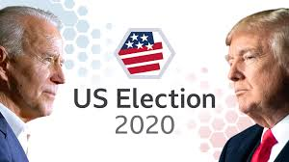
2020 Presidential Election:
Joe Biden (Democrat) defeated incumbent Donald Trump (Republican).
Electoral Vote: Biden won 306 electoral votes, Trump won 232.
Key swing states: Pennsylvania, Georgia, Arizona, Wisconsin.
This was the highest voter turnout in over a century.
The election was significantly impacted by the COVID-19 pandemic and mail-in voting.

Slide 8
U.S. A Senate and Congressional Impact on Elections
Role of the Senate :
Senators serve six-year terms, and one-third of the Senate is up for re-election every two years.
The Senate has significant power in confirming presidential appointments (e.g., Supreme Court justices, cabinet members).
Senate Elections in 2024 :
In 2024, 33 Senate seats will be contested, including seats in battleground states such as Arizona, Georgia, Nevada, and Pennsylvania.
Control of the Senate will be crucial for shaping the legislative agenda and confirming presidential appointments.

Slide 9

Congressional Influence on Presidential Elections :
While Congress doesn’t directly decide the presidential winner, it can influence electoral outcomes, particularly through redistricting, voting laws, and the Electoral College process.

Slide 10
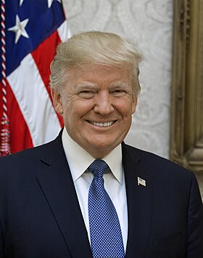
Presidential Candidates of 2024
Donald Trump (Republican Party, 2024):
Immigration: Focuses on border security, wall construction, and deportation of undocumented immigrants.
Economy: Proposes high tariffs on China, tax cuts, and U.S. energy independence through fossil fuels.
Climate Policy: Plans to withdraw from the Paris Agreement and promote fossil fuel expansion.
Foreign Policy: Confronts China, reassesses NATO, and boosts defense, including expanding Space Force.

Slide 11
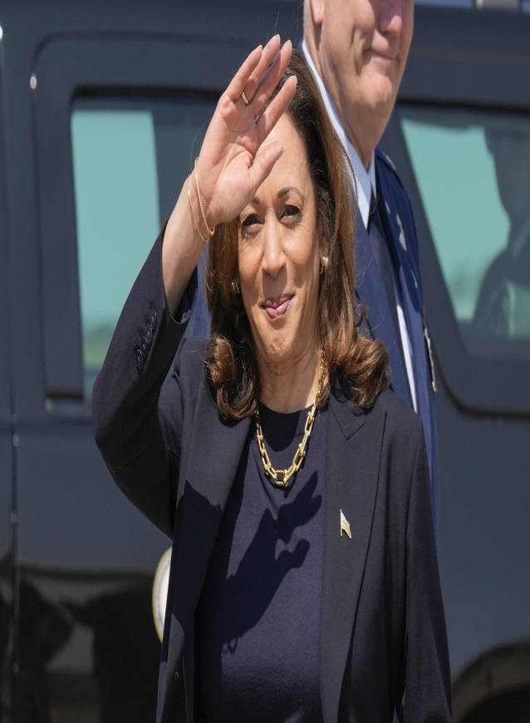
Kamala Harris (Democratic Party, 2024)
healthcare: Advocates for expanded coverage, reproductive rights, and health equity.
Climate Change: Supports renewable energy, carbon reduction, and climate action.
Social Justice: Focuses on criminal justice reform and racial equity.
Education: Supports increased federal investment in education, including free community college.
Immigration: Backs humane reforms and citizenship pathways for Dreamers.

Slide 12
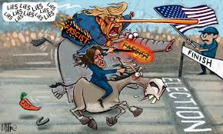
Conclusion
The U.S. presidential election represents the nation's democratic values, offering citizens a chance to shape their future.
The 2024 election is anticipated to be highly competitive, with contrasting visions from Donald Trump and the Democratic candidate.
The results will influence domestic policies, global relationships, and America's role on the world stage.

